Slide 1
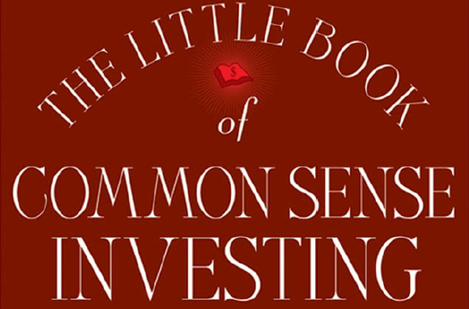
The Little Book of Common Sense Investing By: John C Bogle

Slide 2
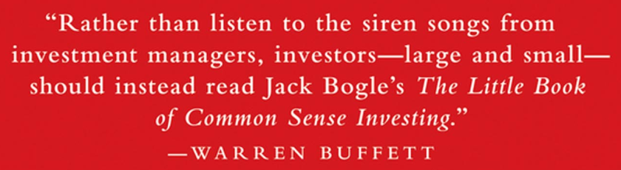
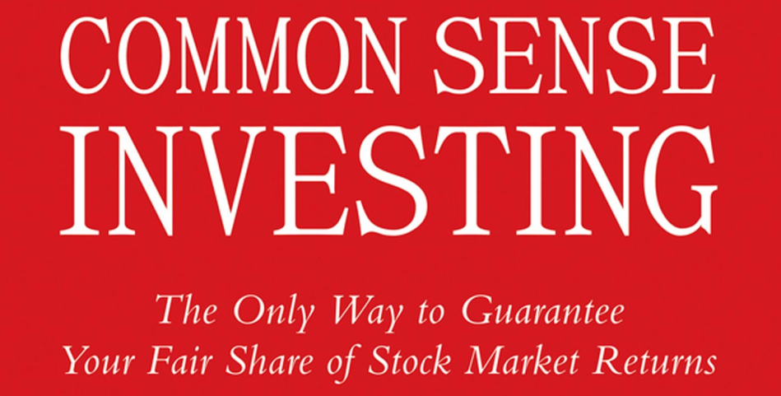

Slide 3
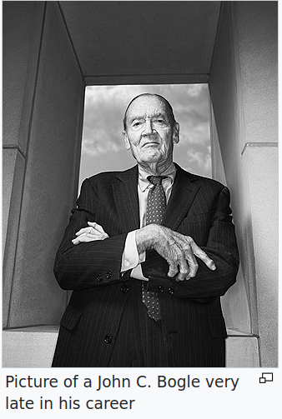
About The Author
John Clifton "Jack" Bogle (May 8, 1929 – January 16, 2019) was an American investor, business magnate, and philanthropist. He was the founder and chief executive of The Vanguard Group, and is credited with creating the index fund. An avid investor and money manager himself, he preached investment over speculation, long-term patience over short-term action, and reducing broker fees as much as possible. The ideal investment vehicle for Bogle was a low-cost index fund held over a lifetime with dividends reinvested and purchased with dollar cost averaging.
His 1999 book ‘Common Sense on Mutual Funds: New Imperatives for the Intelligent Investor’ became a bestseller and is considered a classic within the investment community.

Slide 4
What is an Index Fund?
“SUCCESSFUL INVESTING IS ALL about common sense. As the Oracle has said, it is simple, but it is not easy. Simple arithmetic suggests, and history confirms, that the winning strategy is to own all of the nation’s publicly held businesses at very low cost. By doing so you are guaranteed to capture almost the entire return that they generate. The best way to implement this strategy is indeed simple: Buying a fund that holds this market portfolio, and holding it forever. Such a fund is called an index fund.”

Slide 5
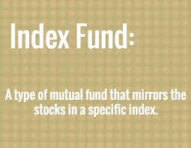
What is an Index Fund? (More Technically)
Index funds are mutual funds that are designed to track the performance of a particular index. For example, “ICICI Prudential Nifty 50 Index Fund” tracks the index Nifty 50.

Slide 6
Index funds eliminate the risks of individual stocks, market sectors, and manager selection. Only stock market risk remains.

Slide 7
Power of Compounding
Please don’t underestimate the power of compounding the generous returns earned by our businesses. Over the past century, our corporations have earned a return on their capital of 9.5 percent per year. Compounded at that rate over a decade, each $1 initially invested grows to $2.48; over two decades, $6.14; over three decades, $15.22; over four decades, $37.72, and over five decades, $93.48.
More than doubling every decade.

Slide 8
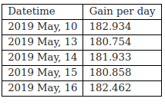
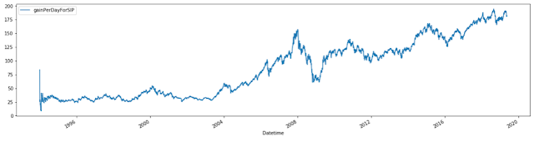
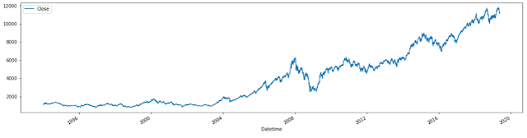
SIP (Systematic Investment Plan) In An Index Fund
Data Dated: Friday, May 17, 2019
What if we invest Rs 1000 every month instead of a one time investment at the inception of the fund?
If we were to invest Rs 1000 each month in Nifty50, we would be having a current value of our investment to be Rs 1,691,507.
The figure 'Gain per day' would stand at: Rs 182.
This is a very slowly changing number:
But if we look at its growth over time, it mimics the original Nifty50 curve but while the range of "Gain per day" is 0 to 185, the range of Nifty50 is 1000 to 12000.
Here is a look at the two curves, On the left "Gain per day", and on the right “Nifty50”:

Slide 9
The Man in The Middle
But the costs of playing the investment game both reduce the gains of the winners and increases the losses of the losers. So who wins? You know who wins. The man in the middle (actually, the men and women in the middle, the brokers, the investment bankers, the money managers, the marketers, the lawyers, the accountants, the operations departments of our financial system) is the only sure winner in the game of investing. Our financial croupiers always win.
In the casino, the house always wins. In horse racing, the track always wins. In the Powerball lottery, the state always wins. Investing is no different. After the deduction of the costs of investing, beating the stock market is a loser’s game.
This book will tell you why you should stop contributing to the croupiers of the financial markets, who rake in something like $400 billion each year from you and your fellow investors. It will also tell you how easy it is to do just that: simply buy the entire stock market. Then, once you have bought your stocks, get out of the casino and stay out. Just hold the market portfolio forever. And that’s what the index fund does.

Slide 10
Once upon a Time...
A wealthy family named the Gotrocks, grown over the generations to include thousands of brothers, sisters, aunts, uncles, and cousins, owned 100 percent of every stock in the United States. Each year, they reaped the rewards of investing: all the earnings growth that those thousands of corporations generated and all the dividends that they distributed.
Each family member grew wealthier at the same pace, and all was harmonious. Their investment had compounded over the decades, creating enormous wealth, because the Gotrocks family was playing a winner’s game.
But after a while, a few fast-talking Helpers arrive on the scene, and they persuade some “smart” Gotrocks cousins that they can earn a larger share than the other relatives. These Helpers convince the cousins to sell some of their shares in the companies to other family members and to buy some shares of others from them in return. The Helpers handle the transactions, and as brokers, they receive commissions for their services. The ownership is thus rearranged among the family members. To their surprise, however, the family wealth begins to grow at a slower pace. Why? Because some of the return is now consumed by the Helpers, and the family’s share of the generous pie that U.S. industry bakes each year 100 percent at the outset, starts to decline, simply because some of the return is now consumed by the Helpers.
The smart cousins quickly realize that their plan has actually diminished the rate of growth in the family’s wealth. They recognize that their foray into stock-picking has been a failure and conclude that they need professional assistance, the better to pick the right stocks for themselves. So they hire stock-picking experts—more Helpers!—to gain an advantage. These money managers charge a fee for their services. So when the family appraises its wealth a year later, it finds that its share of the pie has diminished even further.

Slide 11
Once upon a Time... (Continued)
Alarmed at last, the family sits down together and takes stock of the events that have transpired since some of them began to try to outsmart the others. “How is it,” they ask, “that our original 100 percent share of the pie— made up each year of all those dividends and earnings— has dwindled to just 60 percent?” Their wisest member, a sage old uncle, softly responds: “All that money you’ve
paid to those Helpers and all those unnecessary extra taxes you’re paying come directly out of our family’s total earnings and dividends. Go back to square one, and do so immediately. Get rid of all your brokers. Get rid of all your money managers. Get rid of all your consultants. Then our family will again reap 100 percent of however large a pie that corporate America bakes for us, year after year.”
They followed the old uncle’s wise advice, returning to their original passive but productive strategy, holding all the stocks of corporate America, and standing pat. That is exactly what an index fund does.
. . . and the Gotrocks Family Lived Happily Ever After

Slide 12
The way to wealth for those in the business of investment is to persuade their clients, “Don’t just stand there. Do something.”
But the way to wealth for their clients in the aggregate is to follow the opposite maxim: “Don’t do something. Just stand there.”

Slide 13
Matter of Fact
The higher the level of their investment activity, the greater the cost of financial intermediation and taxes, the less the net return that shareholders—as a group, the owners of our businesses—receive.
For every 20K INR of investment in ICICI Prudential Nifty 50 Index Fund – Growth:
You get units of worth: 19,999 INR
And a stamp duty of 1 INR is charged from you.

Slide 14
The Investor Emotions
We can measure the emotions of the investors by the price/earnings (P/E) ratio, which measures the number of dollars investors are willing to pay for each dollar of earnings. As investor confidence waxes and wanes, P/E multiples rise and fall. When greed holds sway, we see very high P/Es.
When hope prevails, P/Es are moderate. When fear is in the saddle, P/Es are very low. Back and forth, over and over again, swings in the emotions of investors momentarily derail the steady long-range upward trend in the economics of investing.

Slide 15
Regression toward the mean
In statistics, regression toward the mean (also called reversion to the mean, and reversion to mediocrity) is the phenomenon where if one sample of a random variable is extreme, the next sampling of the same random variable is likely to be closer to its mean. Furthermore, when many random variables are sampled and the most extreme results are intentionally picked out, it refers to the fact that (in many cases) a second sampling of these picked-out variables will result in "less extreme" results, closer to the initial mean of all of the variables.
Mathematically, the strength of this "regression" effect is dependent on whether or not all of the random variables are drawn from the same distribution, or if there are genuine differences in the underlying distributions for each random variable. In the first case, the "regression" effect is statistically likely to occur, but in the second case, it may occur less strongly or not at all.
Regression toward the mean is thus a useful concept to consider when designing any scientific experiment, data analysis, or test, which intentionally selects the "most extreme" events - it indicates that follow-up checks may be useful in order to avoid jumping to false conclusions about these events; they may be "genuine" extreme events, a completely meaningless selection due to statistical noise, or a mix of the two cases.

Slide 16
Reversion to Mean
Curiously, without exception, every decade of significantly negative speculative return was immediately followed by a decade in which it turned positive by a correlative amount—the quiet 1910s and then the roaring 1920s, the dispiriting 1940s and then the booming 1950s, the discouraging 1970s and then the soaring 1980s—reversion to the mean (RTM) writ large.
(Reversion to the mean can be thought of as the tendency for stock returns to return to their long-term norms over time—periods of exceptional returns tend to be followed by periods of below average performance, and vice versa.)
Ref: Chapter 2: Rational Exuberance (Shareholder Gains Must Match Business Gains.)

Slide 17
Regression toward the mean
Alternative definition in financial usage:
Jeremy Siegel uses the term "return to the mean" to describe a financial time series in which "returns can be very unstable in the short run but very stable in the long run."
More quantitatively, it is one in which the standard deviation of average annual returns declines faster than the inverse of the holding period, implying that the process is not a random walk, but that periods of lower returns are systematically followed by compensating periods of higher returns, as is the case in many seasonal businesses, for example.
Reference:
Siegel, Jeremy (November 27, 2007). Stocks for the Long Run (4th ed.). McGraw–Hill. pp. 13, 28–29. ISBN 978-0071494700.

Slide 18
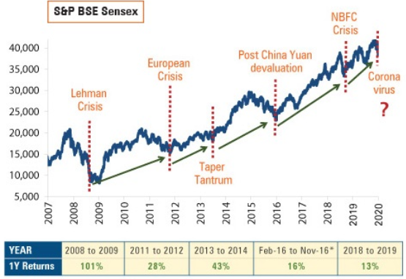
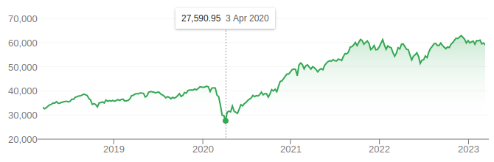
Regression toward the mean

Slide 19
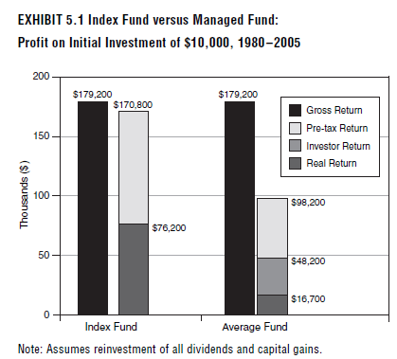

Slide 20
Noise of the Emotions
My advice to investors is to ignore the short-term noise of the emotions reflected in our financial markets and focus on the productive long-term economics of our corporate businesses. Shakespeare could have been describing the inexplicable hourly and daily—sometimes even yearly or longer—fluctuations in the stock market when he wrote, “[It is] like a tale told by an idiot, full of sound and fury, signifying nothing.” The way to investment success is to get out of the expectations market of stock prices and cast your lot with the real market of business.

Slide 21
Don’t Take My Word for It
Simply heed the timeless distinction made by Benjamin Graham, legendary investor, author of The Intelligent Investor, and mentor to Warren Buffett. He was right on the money when he put his finger on the essential reality of investing:
“In the short run the stock market is a voting machine... in the long run it is a weighing machine.”
In the short run, stock market fluctuates with the whims of an investor. In the long run, stock market tells you about the growth of size of the businesses.
Using his wonderful metaphor of “Mr. Market,” Ben Graham says, “Imagine that in some private business you own a small share which cost you $1,000. One of your partners, named Mr. Market, is very obliging indeed. Every day he tells you what he thinks your interest is worth and furthermore offers either to buy you out or to sell you an additional interest on that basis. Sometimes his idea of value appears plausible and justified by business developments and prospects as you know them.
Often, on the other hand, Mr. Market lets his enthusiasm or his fears run away with him, and the value he proposes seems little short of silly.
“If you are a prudent investor... will you let Mr. Market’s daily communication determine your view as the value of your $1,000 interest in the enterprise? Only in case you agree with him, or in case you want to trade with him.... But the rest of the time you will be wiser to form your own ideas of the value of your holdings.... The true investor... will do better if he forgets about the stock market and pays attention to his dividend returns and to the operating results of his companies....“
The investor with a portfolio of sound stocks should expect their prices to fluctuate and should neither be concerned by sizable declines nor become excited by sizable advances. He should always remember that market quotations are there for his convenience, either to be taken advantage of or to be ignored.”

Slide 22
From the chapter: “How Most Investors Turn a Winner’s Game into a Loser’s Game”
All investors as a group must necessarily earn precisely the market return, but only before the costs of investing are deducted.
There are, then, these two certainties:
(1) Beating the market before costs is a zero-sum game;
(2) Beating the market after costs is a loser’s game.

Slide 23
Ch 4: How Most Investors Turn a Winner’s Game into a Loser’s Game
“The Relentless Rules of Humble Arithmetic”
“Costs matter”
A few years ago when I was rereading Other People’s Money, by Louis D. Brandeis (first published in 1914), I came across a wonderful passage that illustrates this simple lesson. Brandeis, later to become one of the most influential jurists in the history of the U.S. Supreme Court, railed against the oligarchs who a century ago controlled investment America and corporate America alike.
Brandeis described their self-serving financial management and their interlocking interests as “trampling with impunity on laws human and divine, obsessed with the delusion that two plus two make five.” He predicted (accurately, as it turned out) that the widespread speculation of that era would collapse, “a victim of the relentless rules of humble arithmetic.” He then added this unattributed warning (I’m guessing it’s from Sophocles): “Remember, O Stranger, arithmetic is the first of the sciences, and the mother of safety.”
Brandeis’s words hit me like the proverbial ton of bricks. Why? Because the relentless rules of the arithmetic of investing are so obvious. (It’s been said by my detractors that all I have going for me is “the uncanny ability to recognize the obvious.”) The curious fact is that most investors seem to have difficulty recognizing what lies in plain sight, right before their eyes. Or, perhaps even more pervasively, they refuse to recognize the reality because it flies in the face of their deep-seated beliefs, biases, overconfidence, and uncritical acceptance of the way that financial markets have worked, seemingly forever.
What’s more, it is hardly in the interest of our financial intermediaries to encourage their investor/clients to recognize the obvious reality. Indeed, the self-interest of the leaders of our financial system almost compels them to ignore these relentless rules.
Paraphrasing Upton Sinclair: It’s amazing how difficult it is for a man to understand something if he’s paid a small fortune not to understand it.
Our system of financial intermediation has created enormous fortunes for those who manage other people’s money. Their self-interest will not soon change. But as an investor, you must look after yourr self-interest. Only by facing the obvious realities of investing can an intelligent investor succeed.

Slide 24
Ch 5: Focus on the Lowest-Cost Funds
The More the Managers Take, the Less the Investors Make.
If the managers take nothing, the investors receive everything: the market’s return.

Slide 25
Don’t Take My Word for It
The wise Warren Buffett shares my view. Consider what I call his four E’s.
“The greatest Enemies of the Equity investor are Expenses and Emotions.”
So does Andrew Lo, MIT professor and author of Adaptive Markets (2017), who personally “invests by buying and holding index funds.”
***
Perhaps even more surprisingly, the founder and chief executive of the largest mutual fund supermarket—while vigorously promoting stock trading and actively managed funds—favors the classic index fund for himself. When asked why people invest in managed funds, Charles Schwab answered: “It’s fun to play around . . . it’s human nature to try to select the right horse...
[But] for the average person, I’m more of an indexer.... The predictability is so high.... For 10, 15, 20 years you’ll be in the 85th percentile of performance. Why would you screw it up?” (Most of Mr. Schwab’s personal portfolio is invested in index funds.)
***
Mark Hulbert, editor of the highly regarded Hulbert Financial Digest, concurs. “Assuming that the future is like the past, you can outperform 80 percent of your fellow investors over the next several decades by investing in an index fund—and doing nothing else. . . . [A]cquire the discipline to do something even better [than trying to beat the market]: become a long-term index fund investor.”
His New York Times article was headlined: “Buy and Hold? Sure, but Don’t Forget the ‘Hold.’”

Slide 26
Ch 8: Taxes Are Costs, Too
Don’t Pay Uncle Sam Any More Than You Should.
A word about Indian Income Tax Rules:
Mutual fund tax benefits under Section 80C:
Investments in Equity Linked Savings Schemes or ELSS mutual funds qualify for deduction from your taxable income under Section 80C of the Income Tax Act 1961. The maximum investment amount eligible for tax deduction under Section 80C, is Rs 1.5 lakhs.
Index funds such as “ICICI Prudential Nifty 50 Index Fund” do not fall under 80C.
For tax saving purpose, you can go for funds like: “ICICI Prudential Long Term Equity Fund (Tax Saving)”
A Word About “Long Term Capital Gain” Tax
The LTCG of up to Rs. 1 lakh is tax-free, whereas gains over Rs. 1 Lakh is subject to LTCG tax of 10% (plus 4% cess) without any indexation benefit. Equity-Linked Saving Scheme (ELSS funds) is another equity scheme that is the most efficient tax saving scheme under Section 80C.

Slide 27
Ch 9: When the Good Times No Longer Roll
It’s Wise to Plan on Lower Future Returns in the Stock and Bond Markets.
Here we can talk about holding a job or a more regular source of income. And then doing an SIP from this source of income.
FAQ: What all factors should we consider while selecting an index fund from any bank?
1. Stamp duty (For ICICI Prudential Nifty 50 Index Fund, 1 Rs for every Rs 20K of investment)
2. Lock-in period (NA for ICICI Prudential Nifty 50 Index Fund)
3. Exit charges (NA for ICICI Prudential Nifty 50 Index Fund)
4. Fund manager fees (NA for ICICI Prudential Nifty 50 Index Fund)
5. Tax exemption (Income from ICICI Prudential Nifty 50 Index Fund is taxable)

